Slide 1
OOPS + C#

Slide 2
Reference type variable

Slide 3
Concrete Class

Slide 4
Differences Between Task And Thread?
The Thread class is used for creating and manipulating a thread in Windows. A Task represents some asynchronous operation and is part of the Task Parallel Library, a set of APIs for running tasks asynchronously and in parallel.
The task can return a result. There is no direct mechanism to return the result from a thread.
Task supports cancellation through the use of cancellation tokens. But Thread doesn't.
A task can have multiple processes happening at the same time. Threads can only have one task running at a time.
We can easily implement Asynchronous using ’async’ and ‘await’ keywords.
A new Thread()is not dealing with Thread pool thread, whereas Task does use thread pool thread.
A Task is a higher level concept than Thread.
static void Main(string[] args) { Task < string > obTask = Task.Run(() => ( return“ Hello”)); Console.WriteLine(obTask.result); } | static void Main(string[] args) { Thread thread = new Thread(new ThreadStart(getMyName)); thread.Start(); } public void getMyName() {}

Slide 5
Abstract Class

Slide 6
Extension Method

Slide 7
StringBuilder

Slide 8
Collection

Slide 9
Array vs ArrayList

Slide 10
Virtual Method

Slide 11
Event

Slide 12
Delegate

Slide 13
Abstract class vs interface

Slide 14


Slide 15
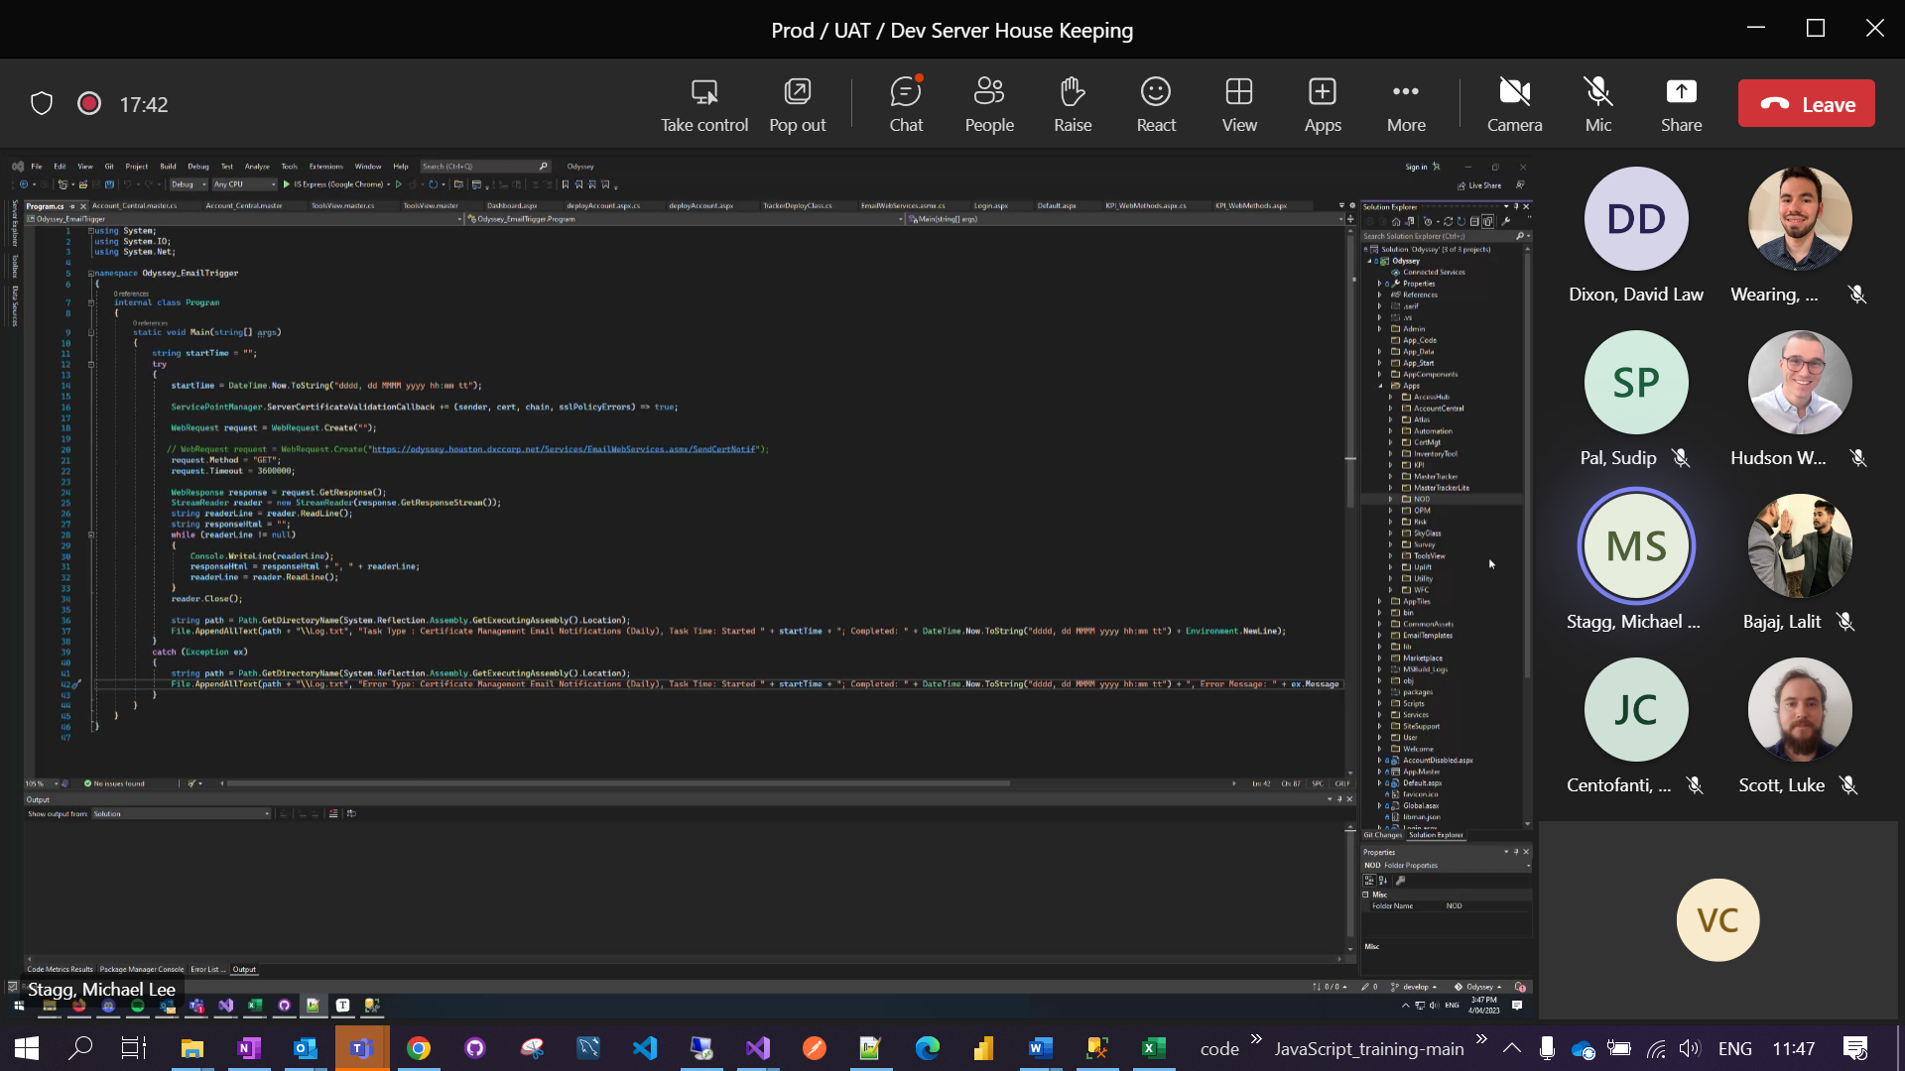

Slide 16
Design Principle vs Design Pattern

Slide 17
Liskov substitution principle
Liskov Substitution Principle (LSP) states that objects of a superclass should be replaceable with objects of its subclasses without breaking the application. In other words, what we want is to have the objects of our subclasses behaving the same way as the objects of our superclass.

Slide 18
Communication between two thread or how to pass information from one thread to another thread.

Slide 19
Thread

